Slide 1
Create an aws account and IAM user

Slide 2
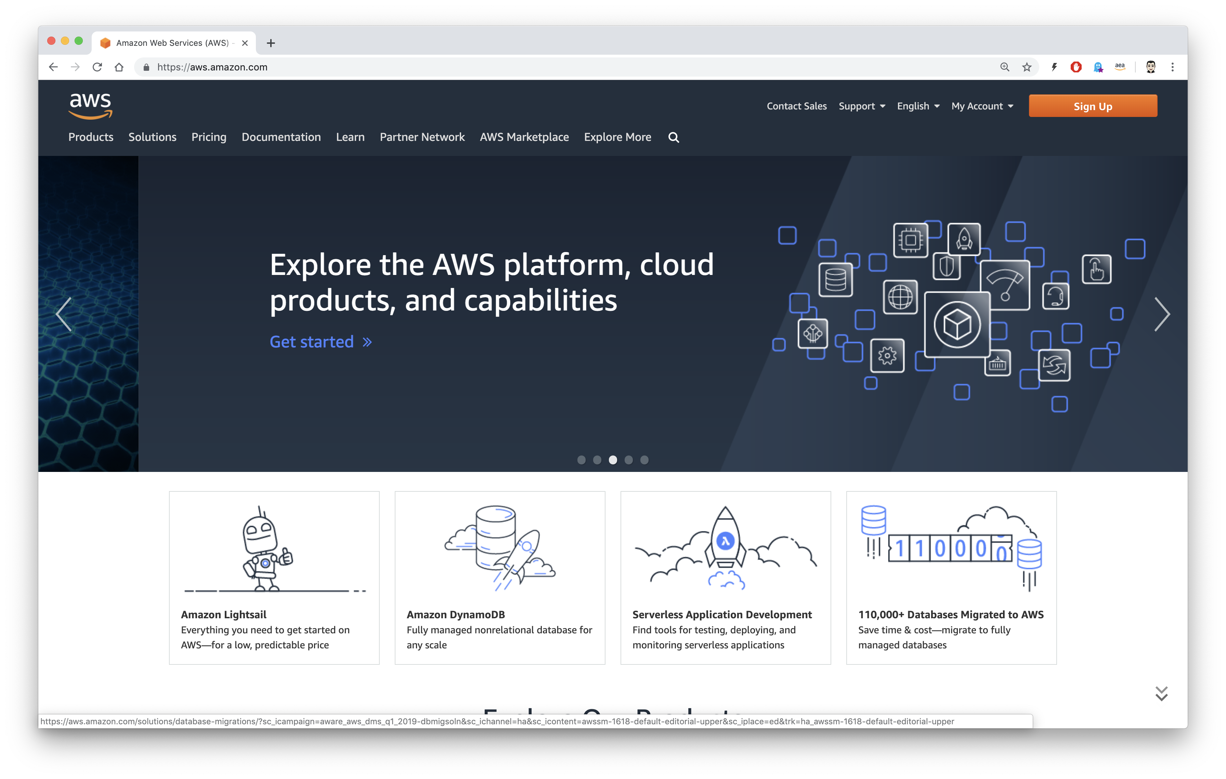

Sign Up for AWS
Navigate to https://aws.amazon.com and click on “Sign Up” Sometimes it says “Create an AWS Account” or “Create a Free Account”. If you have trouble navigate to: https://portal.aws.amazon.com/gp/aws/developer/registration/index.html
If it says “Sign In to the Console” you may already have an account and you can
sign in and skip to the “Create an IAM user” section.

Slide 3
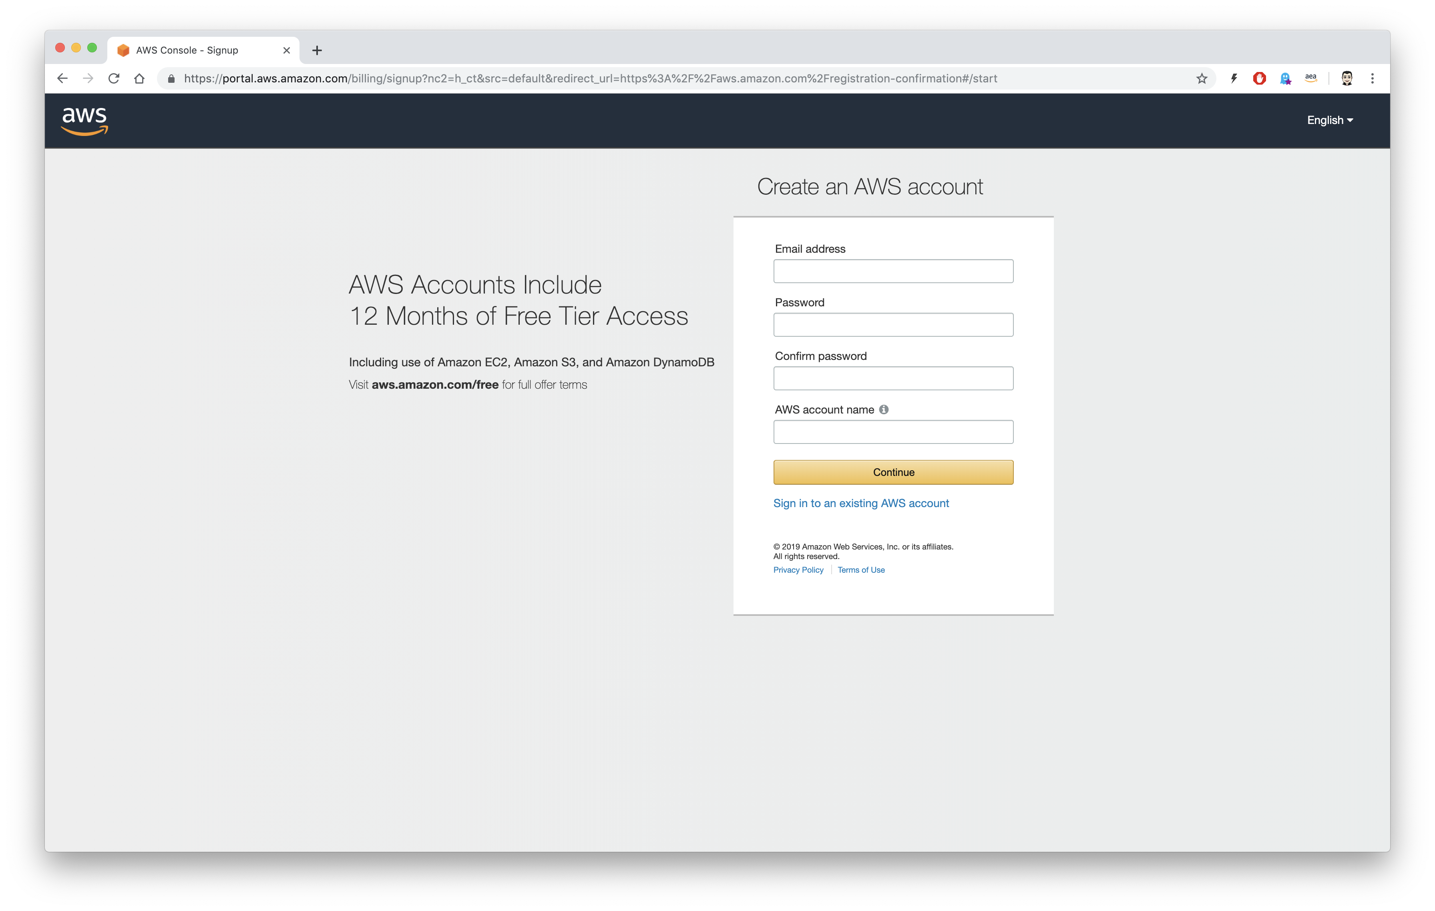

Fill out your information
Fill out the information and keep the password.

Slide 4
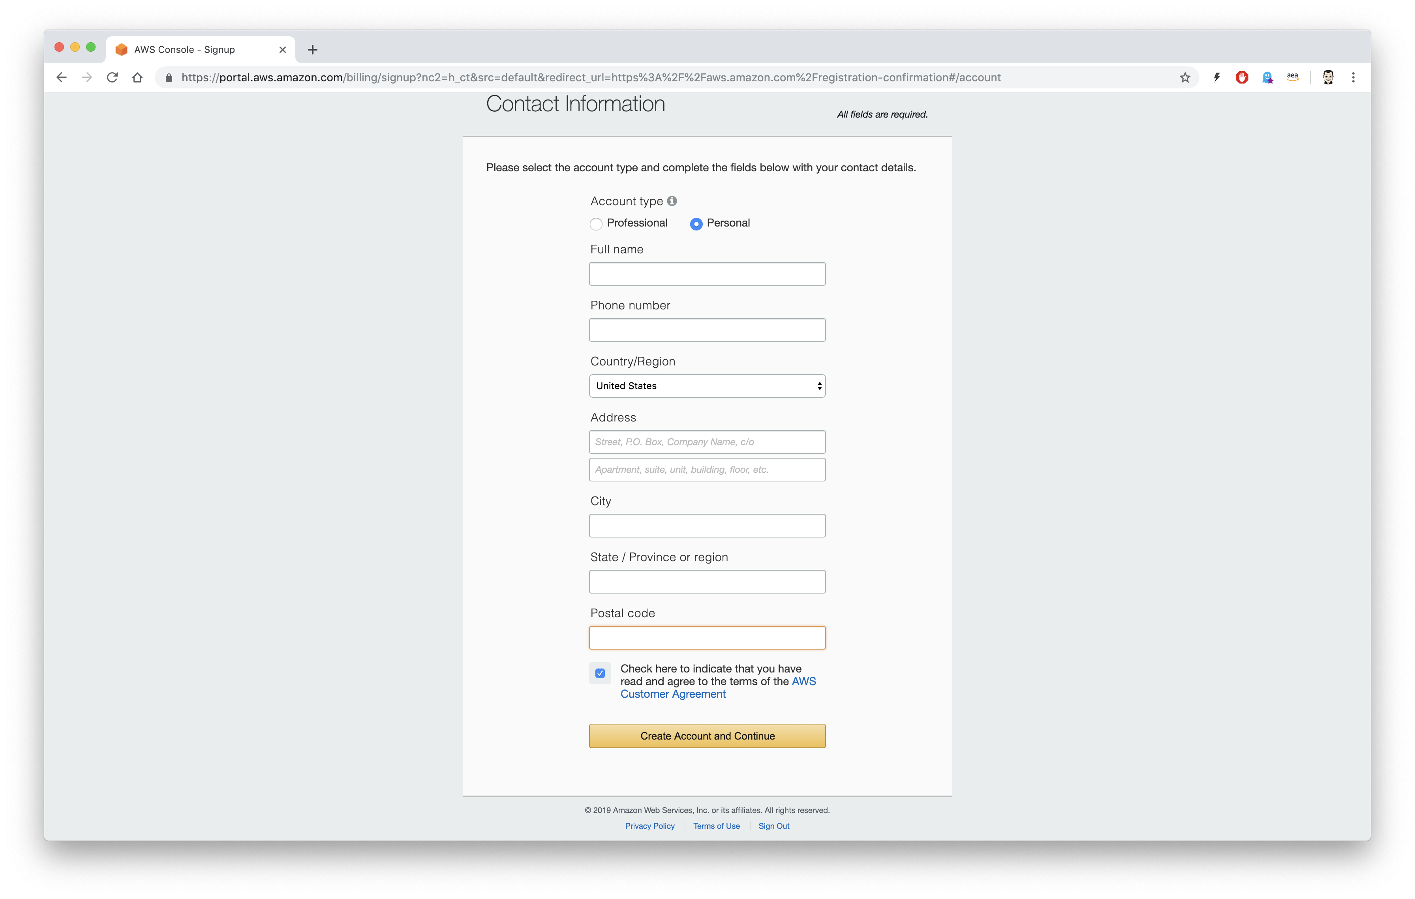


Choose Personal, fill our your information and click on Create Account and Continue

Slide 5
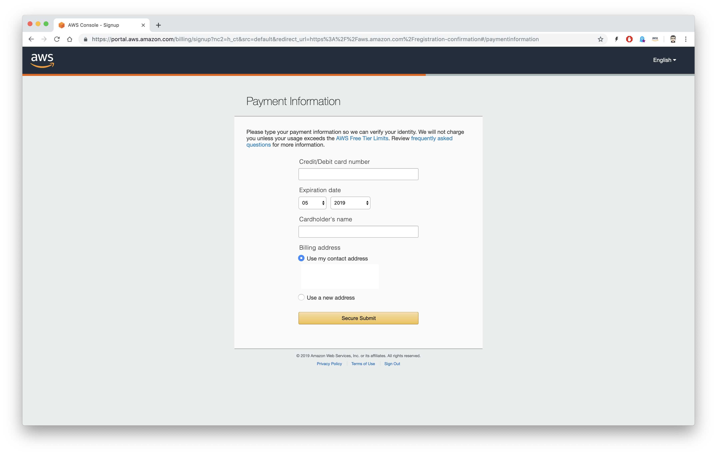

Payment Information
Fill out your payment information

Slide 6
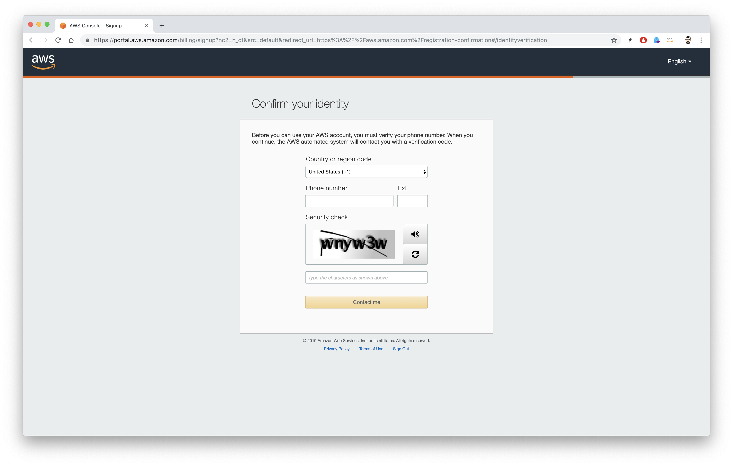

Confirm you Identity
Confirm you identity and click Contact me. You will receive a call.

Slide 7
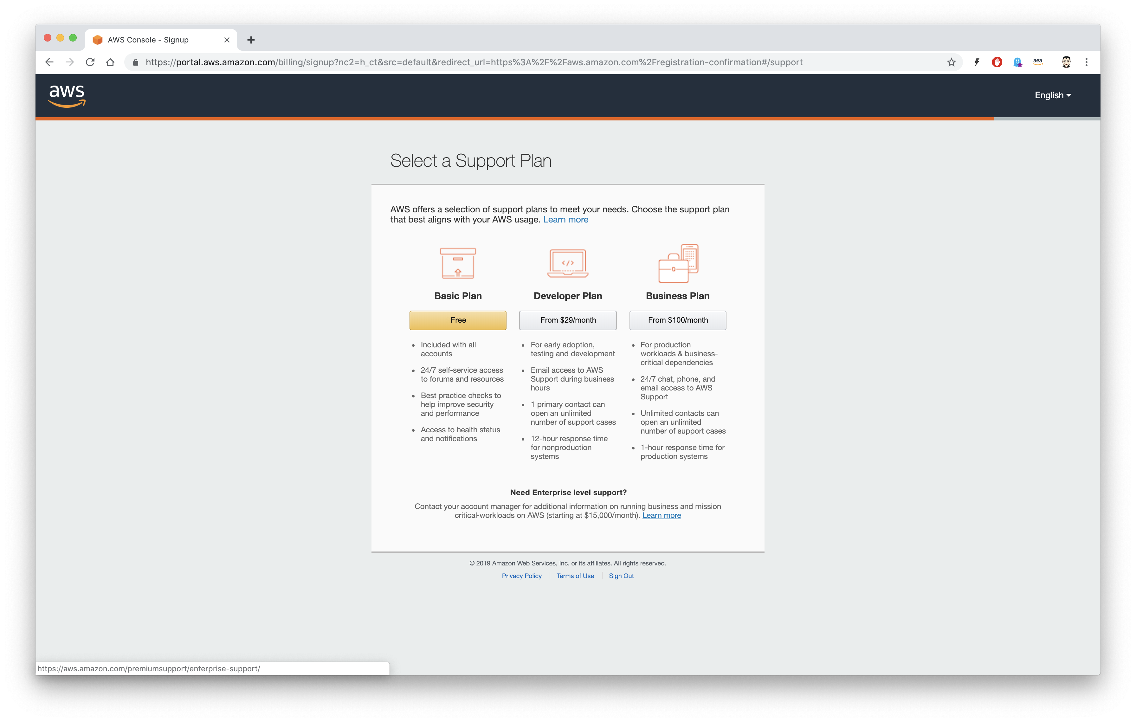

Select a Support Plan
Choose the Basic Plan.

Slide 8
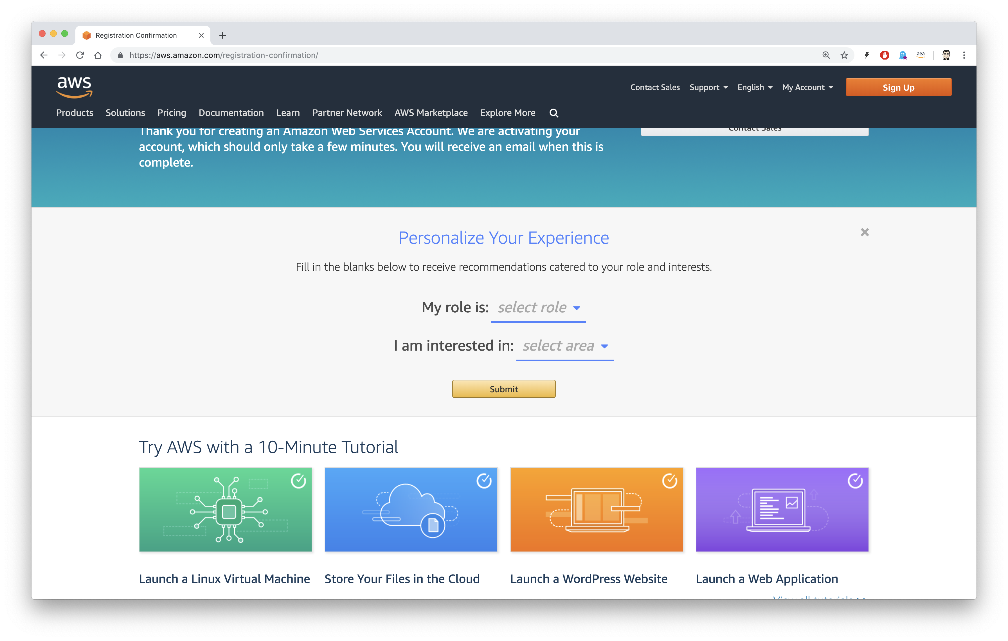

Personalize Your Experience
Fill out your role and interest.

Slide 9
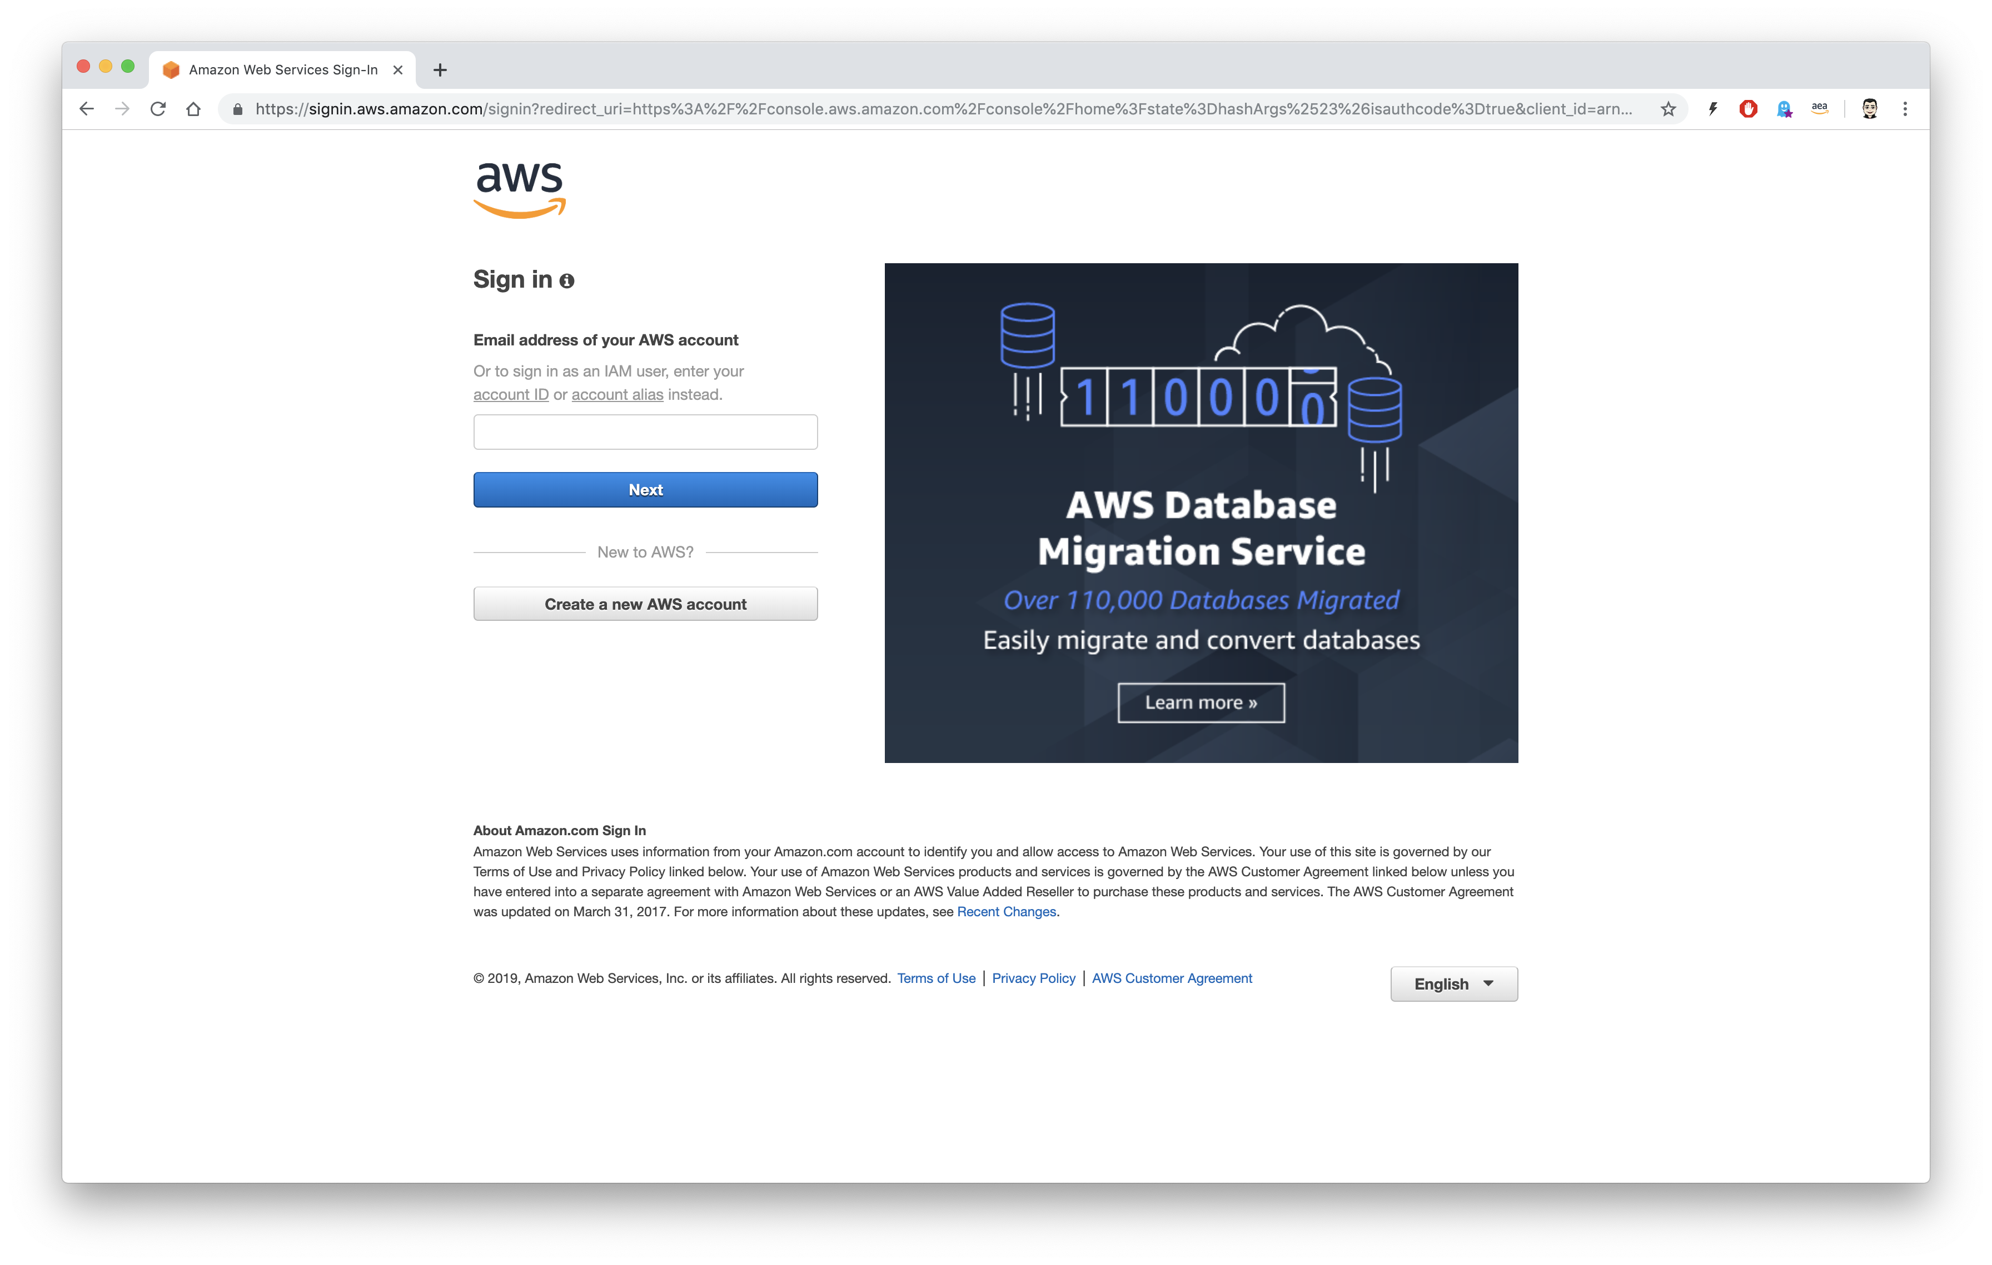

Sign in to the root account
Sign in using your email address.

Slide 10
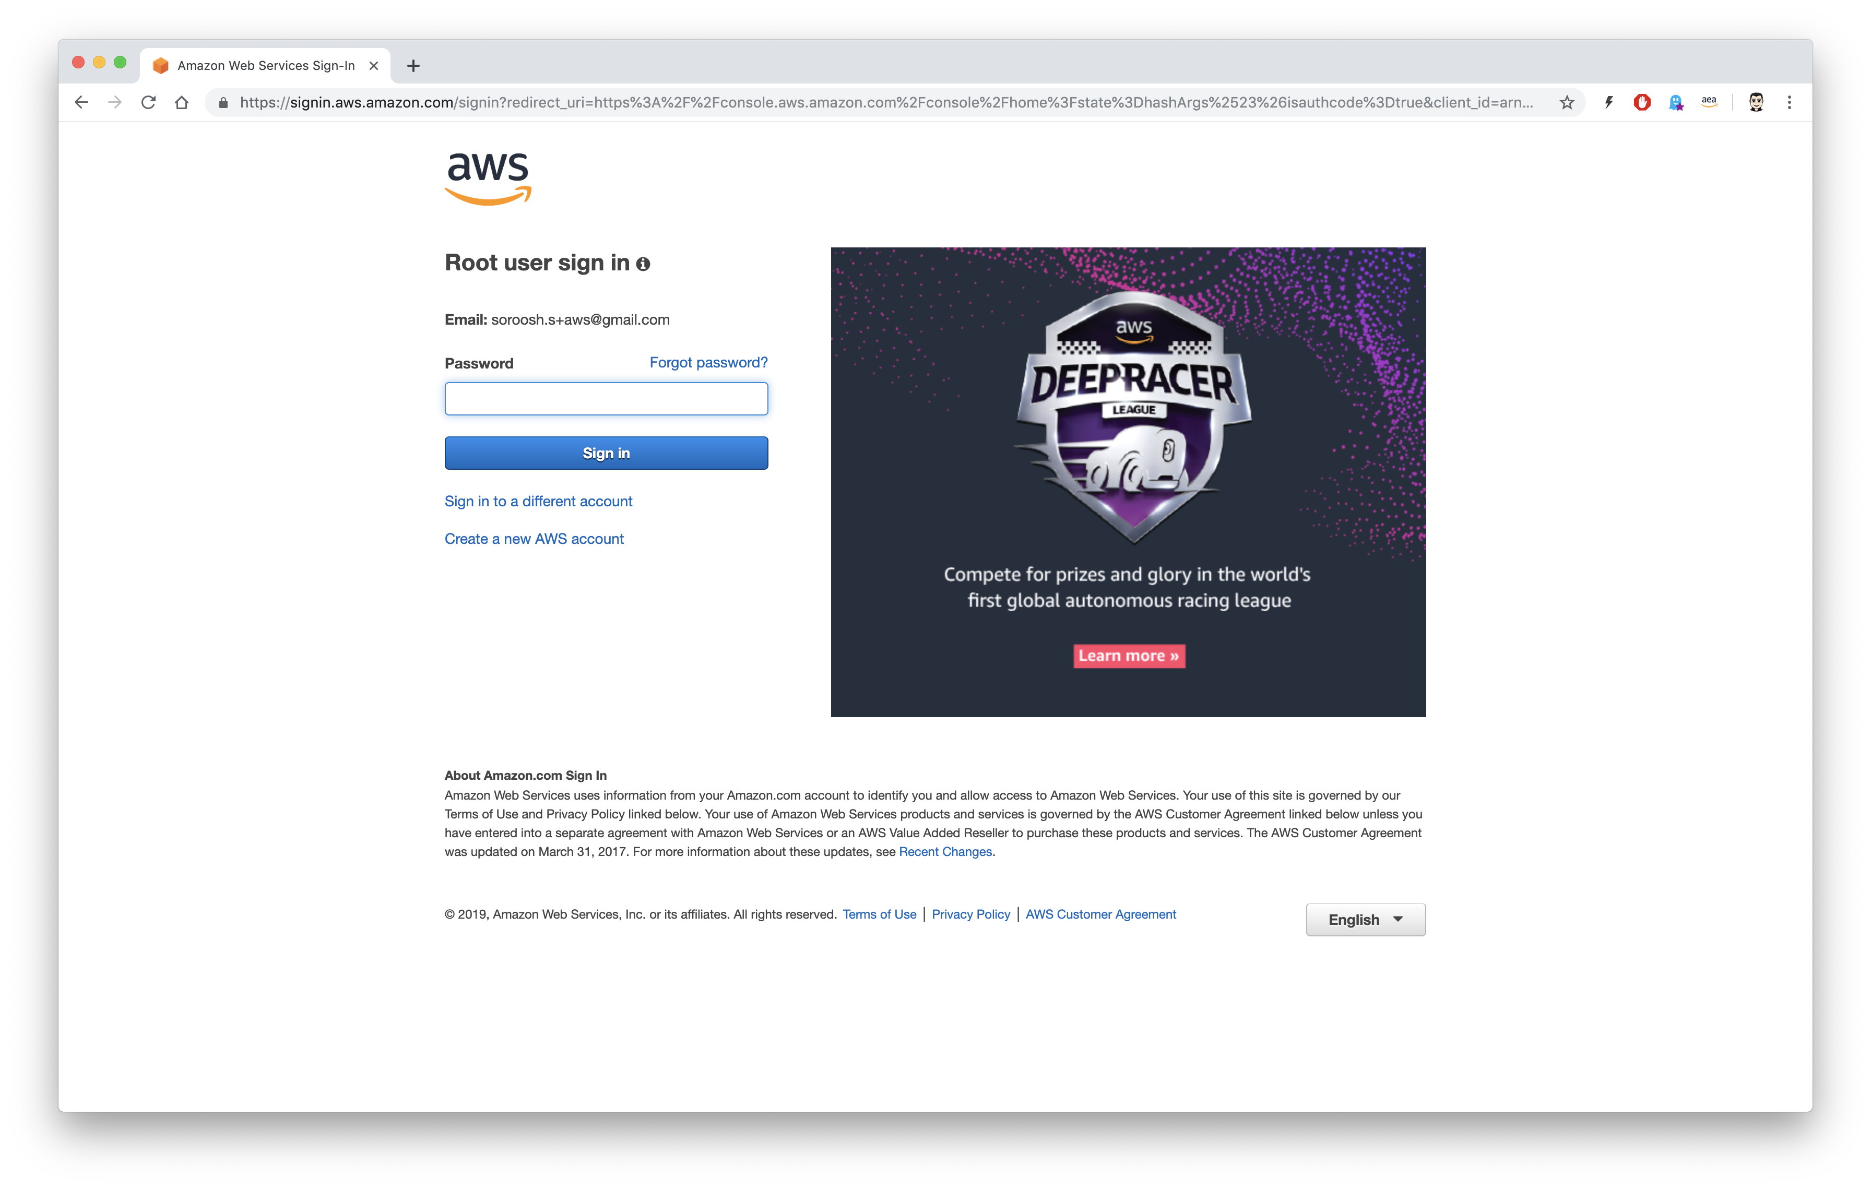

Root user sign in
Enter your password

Slide 11
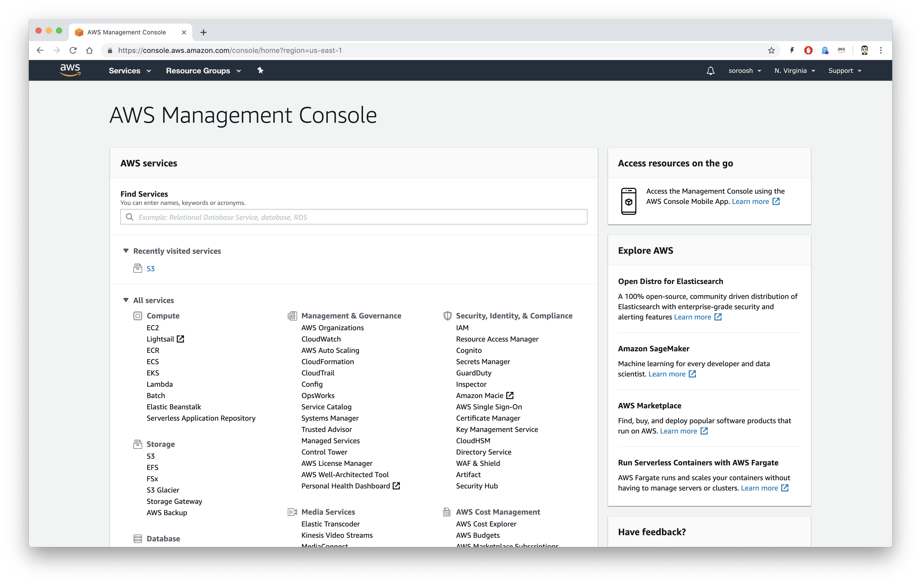
AWS Management Console
Now you are in the AWS Management Console

Slide 12
Create an IAM user

Slide 13
It is NOT best practice to use your root account for daily work. Let us create an IAM user, with administrator privileges, and use this user instead of the root user.

Slide 14
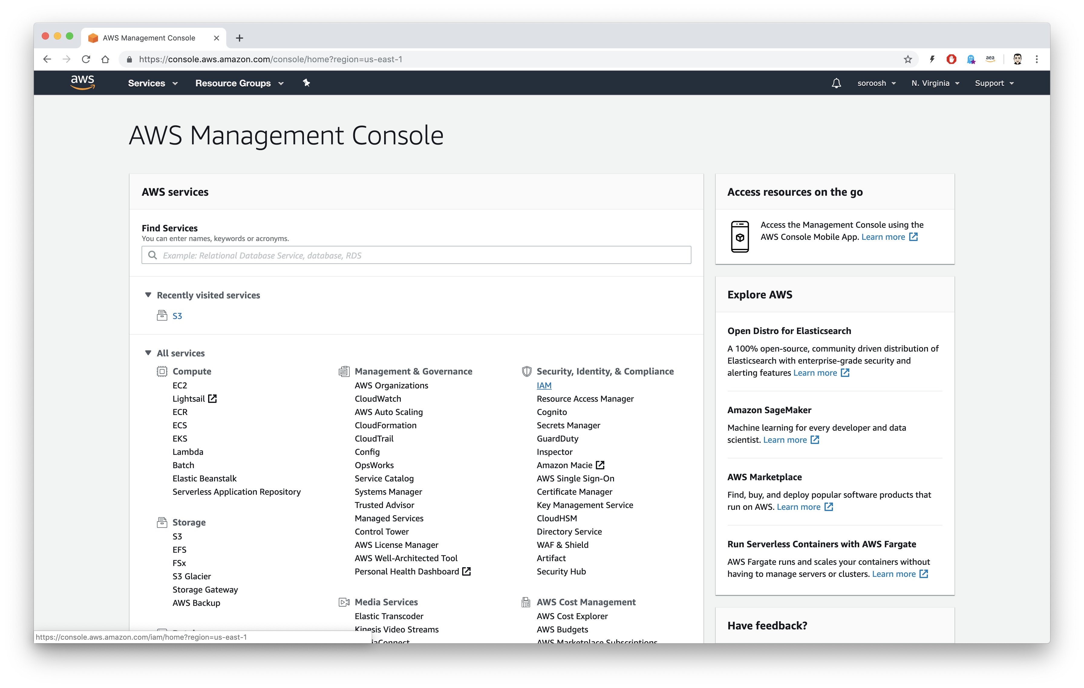


Choose IAM
Expand All services and choose IAM under Security, Identity, & Compliance

Slide 15
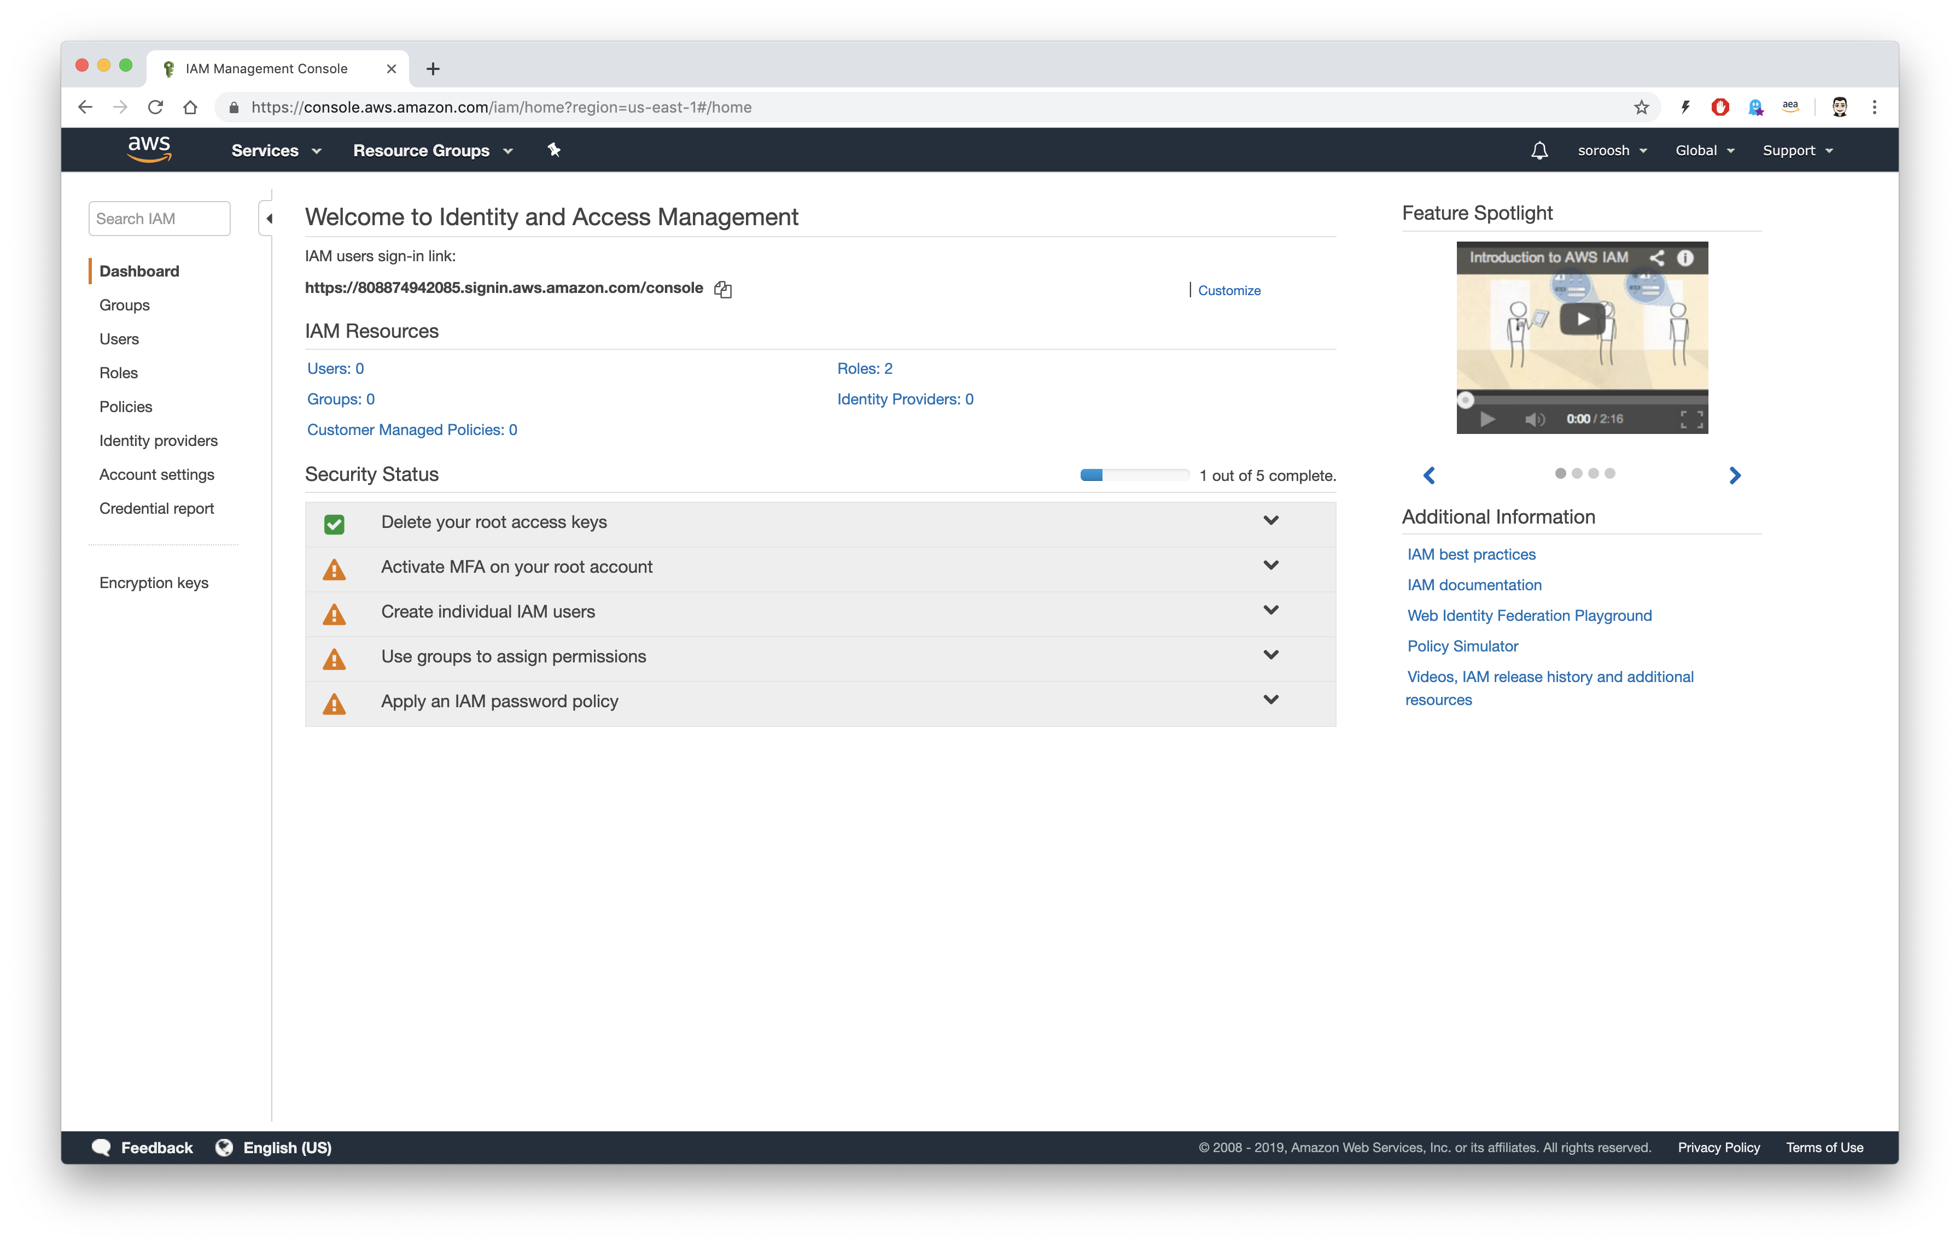

Create a new user
Click on Users

Slide 16
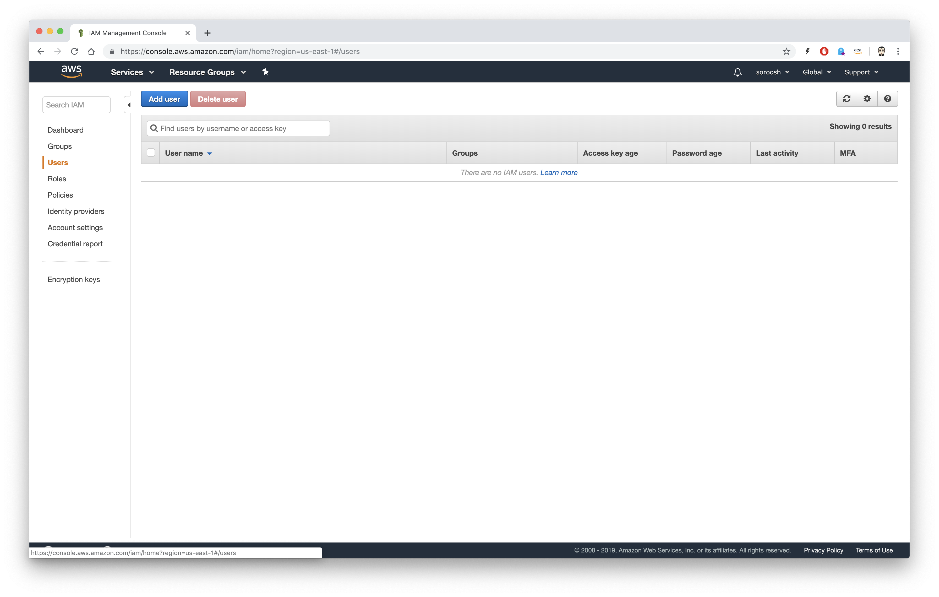

Add new user
Click on Add user

Slide 17
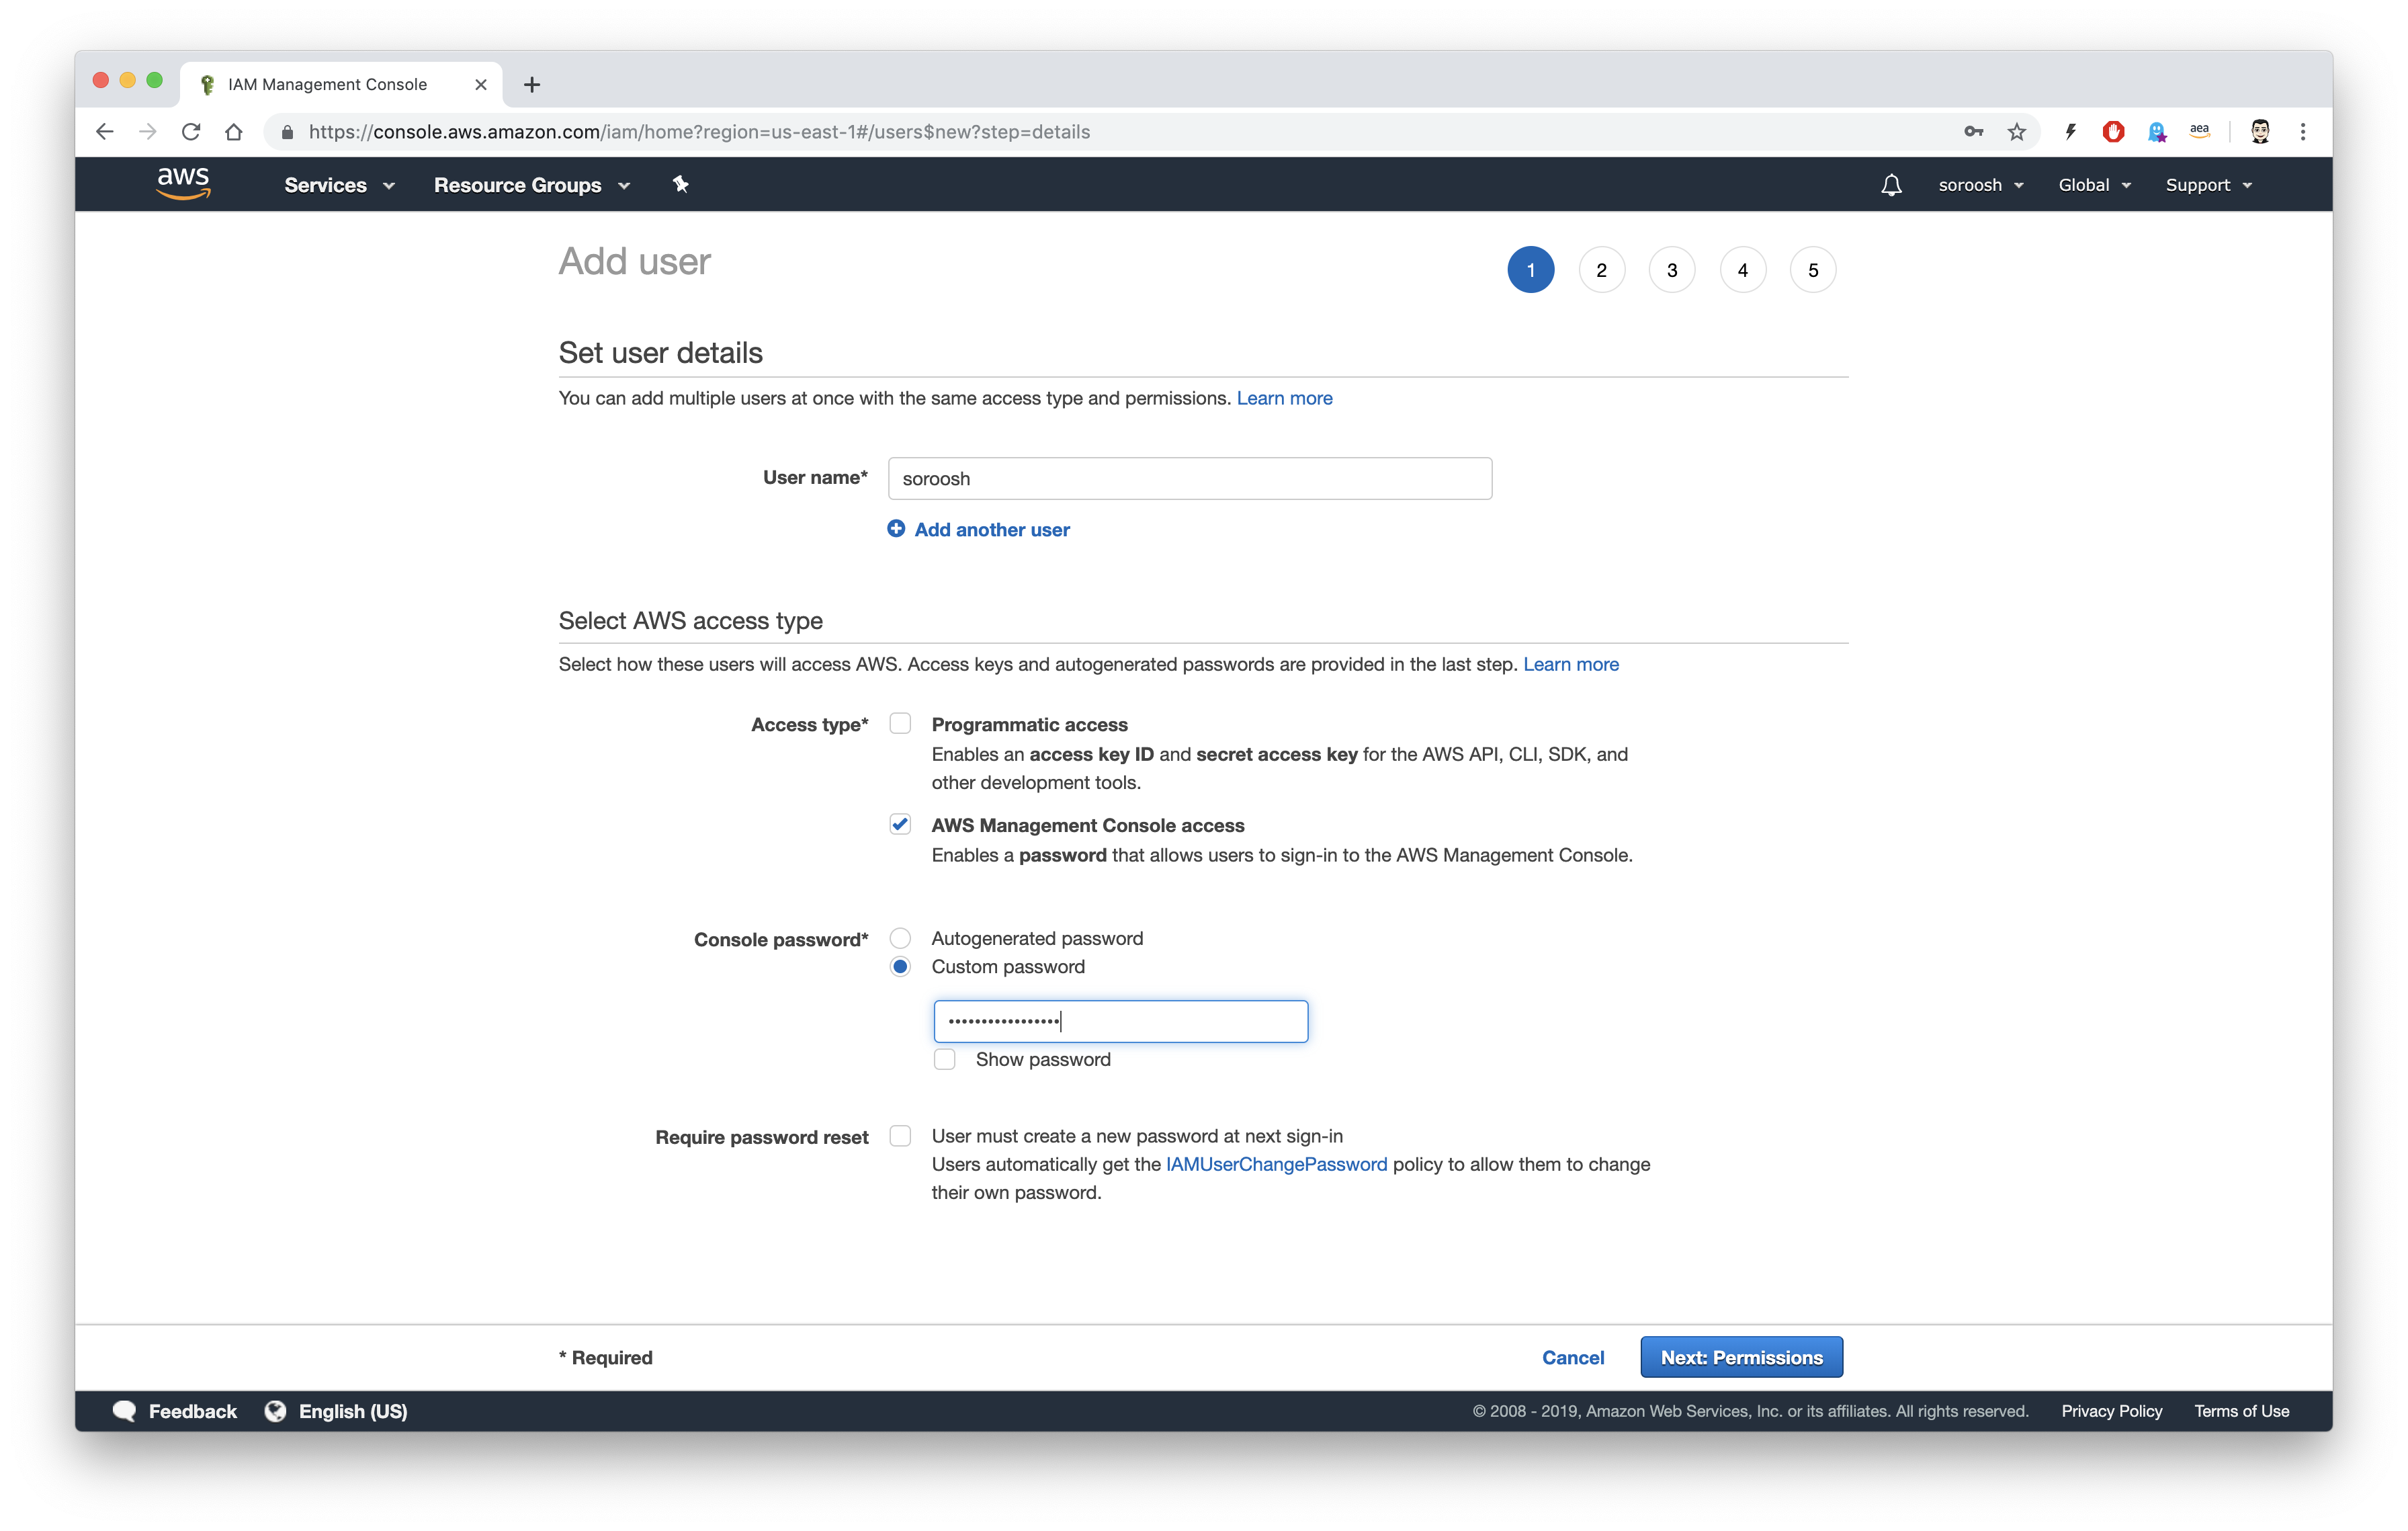




Add user
Enter your User name, choose the right Access type and enter the password, then click on Next: Permissions

Slide 18
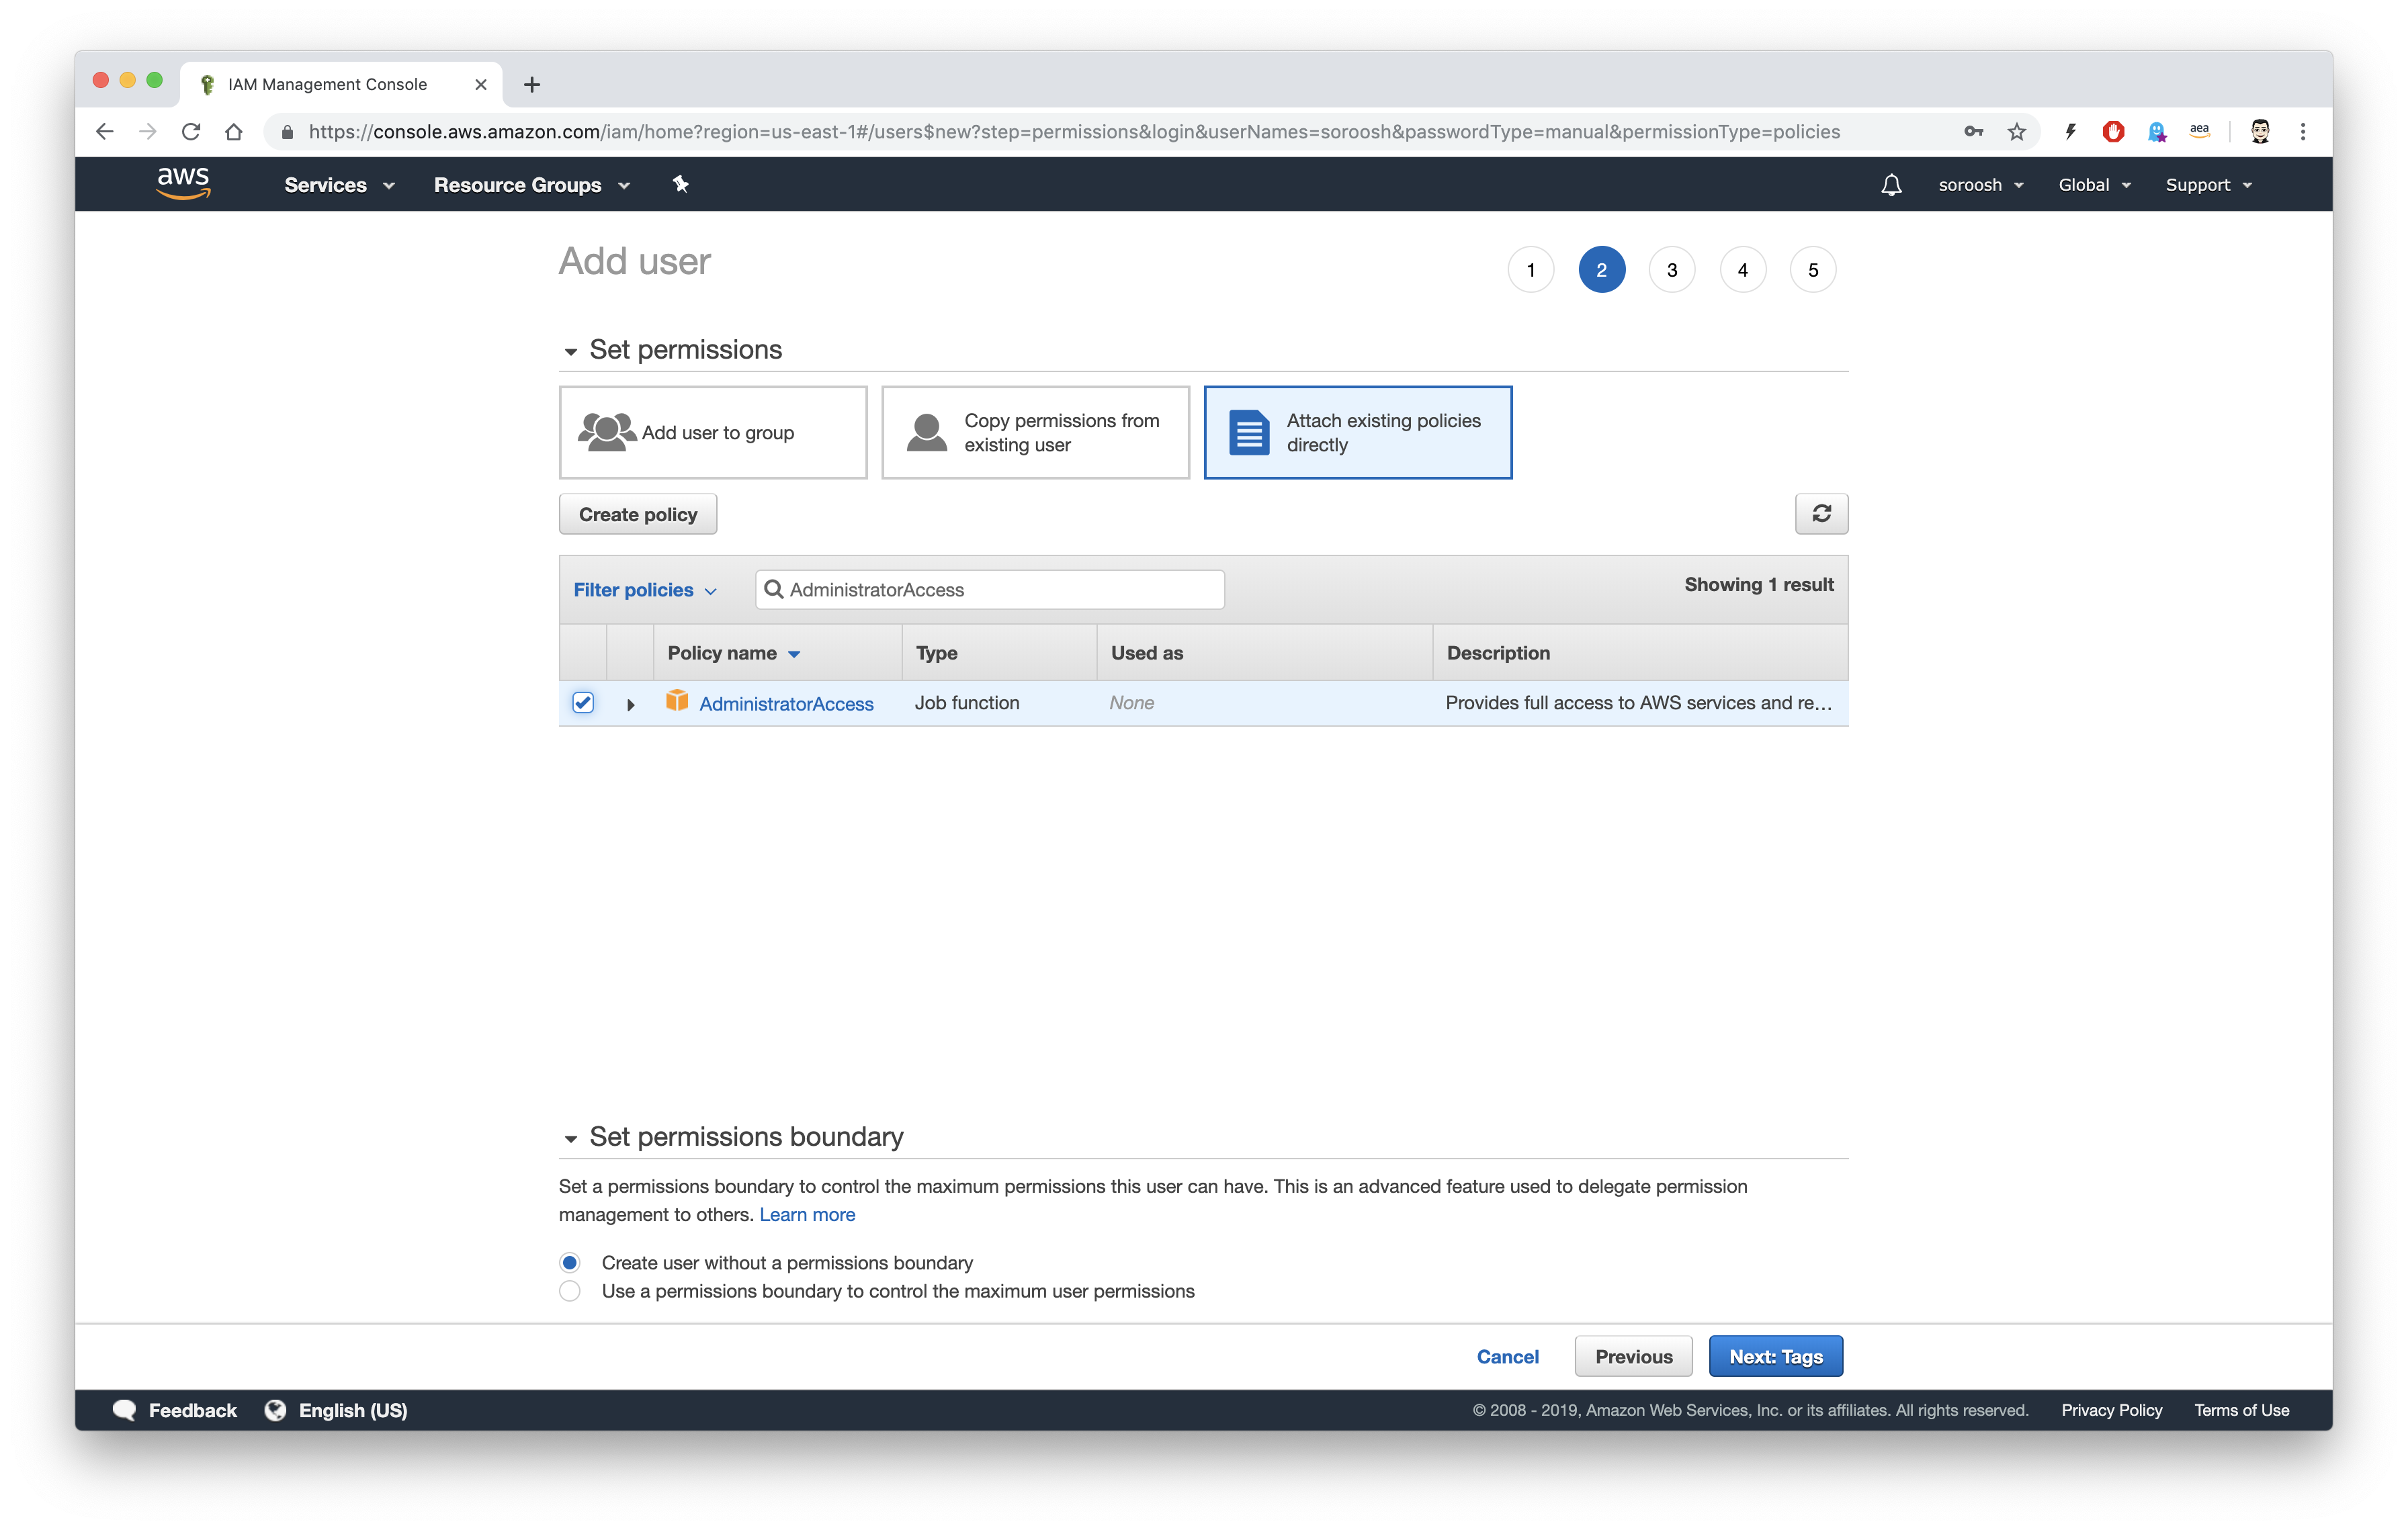


Set Policies
Choose Attach existing Policies directly, find Administrator Access, click on the box to choose the policy and click on Next: Tags

Slide 19
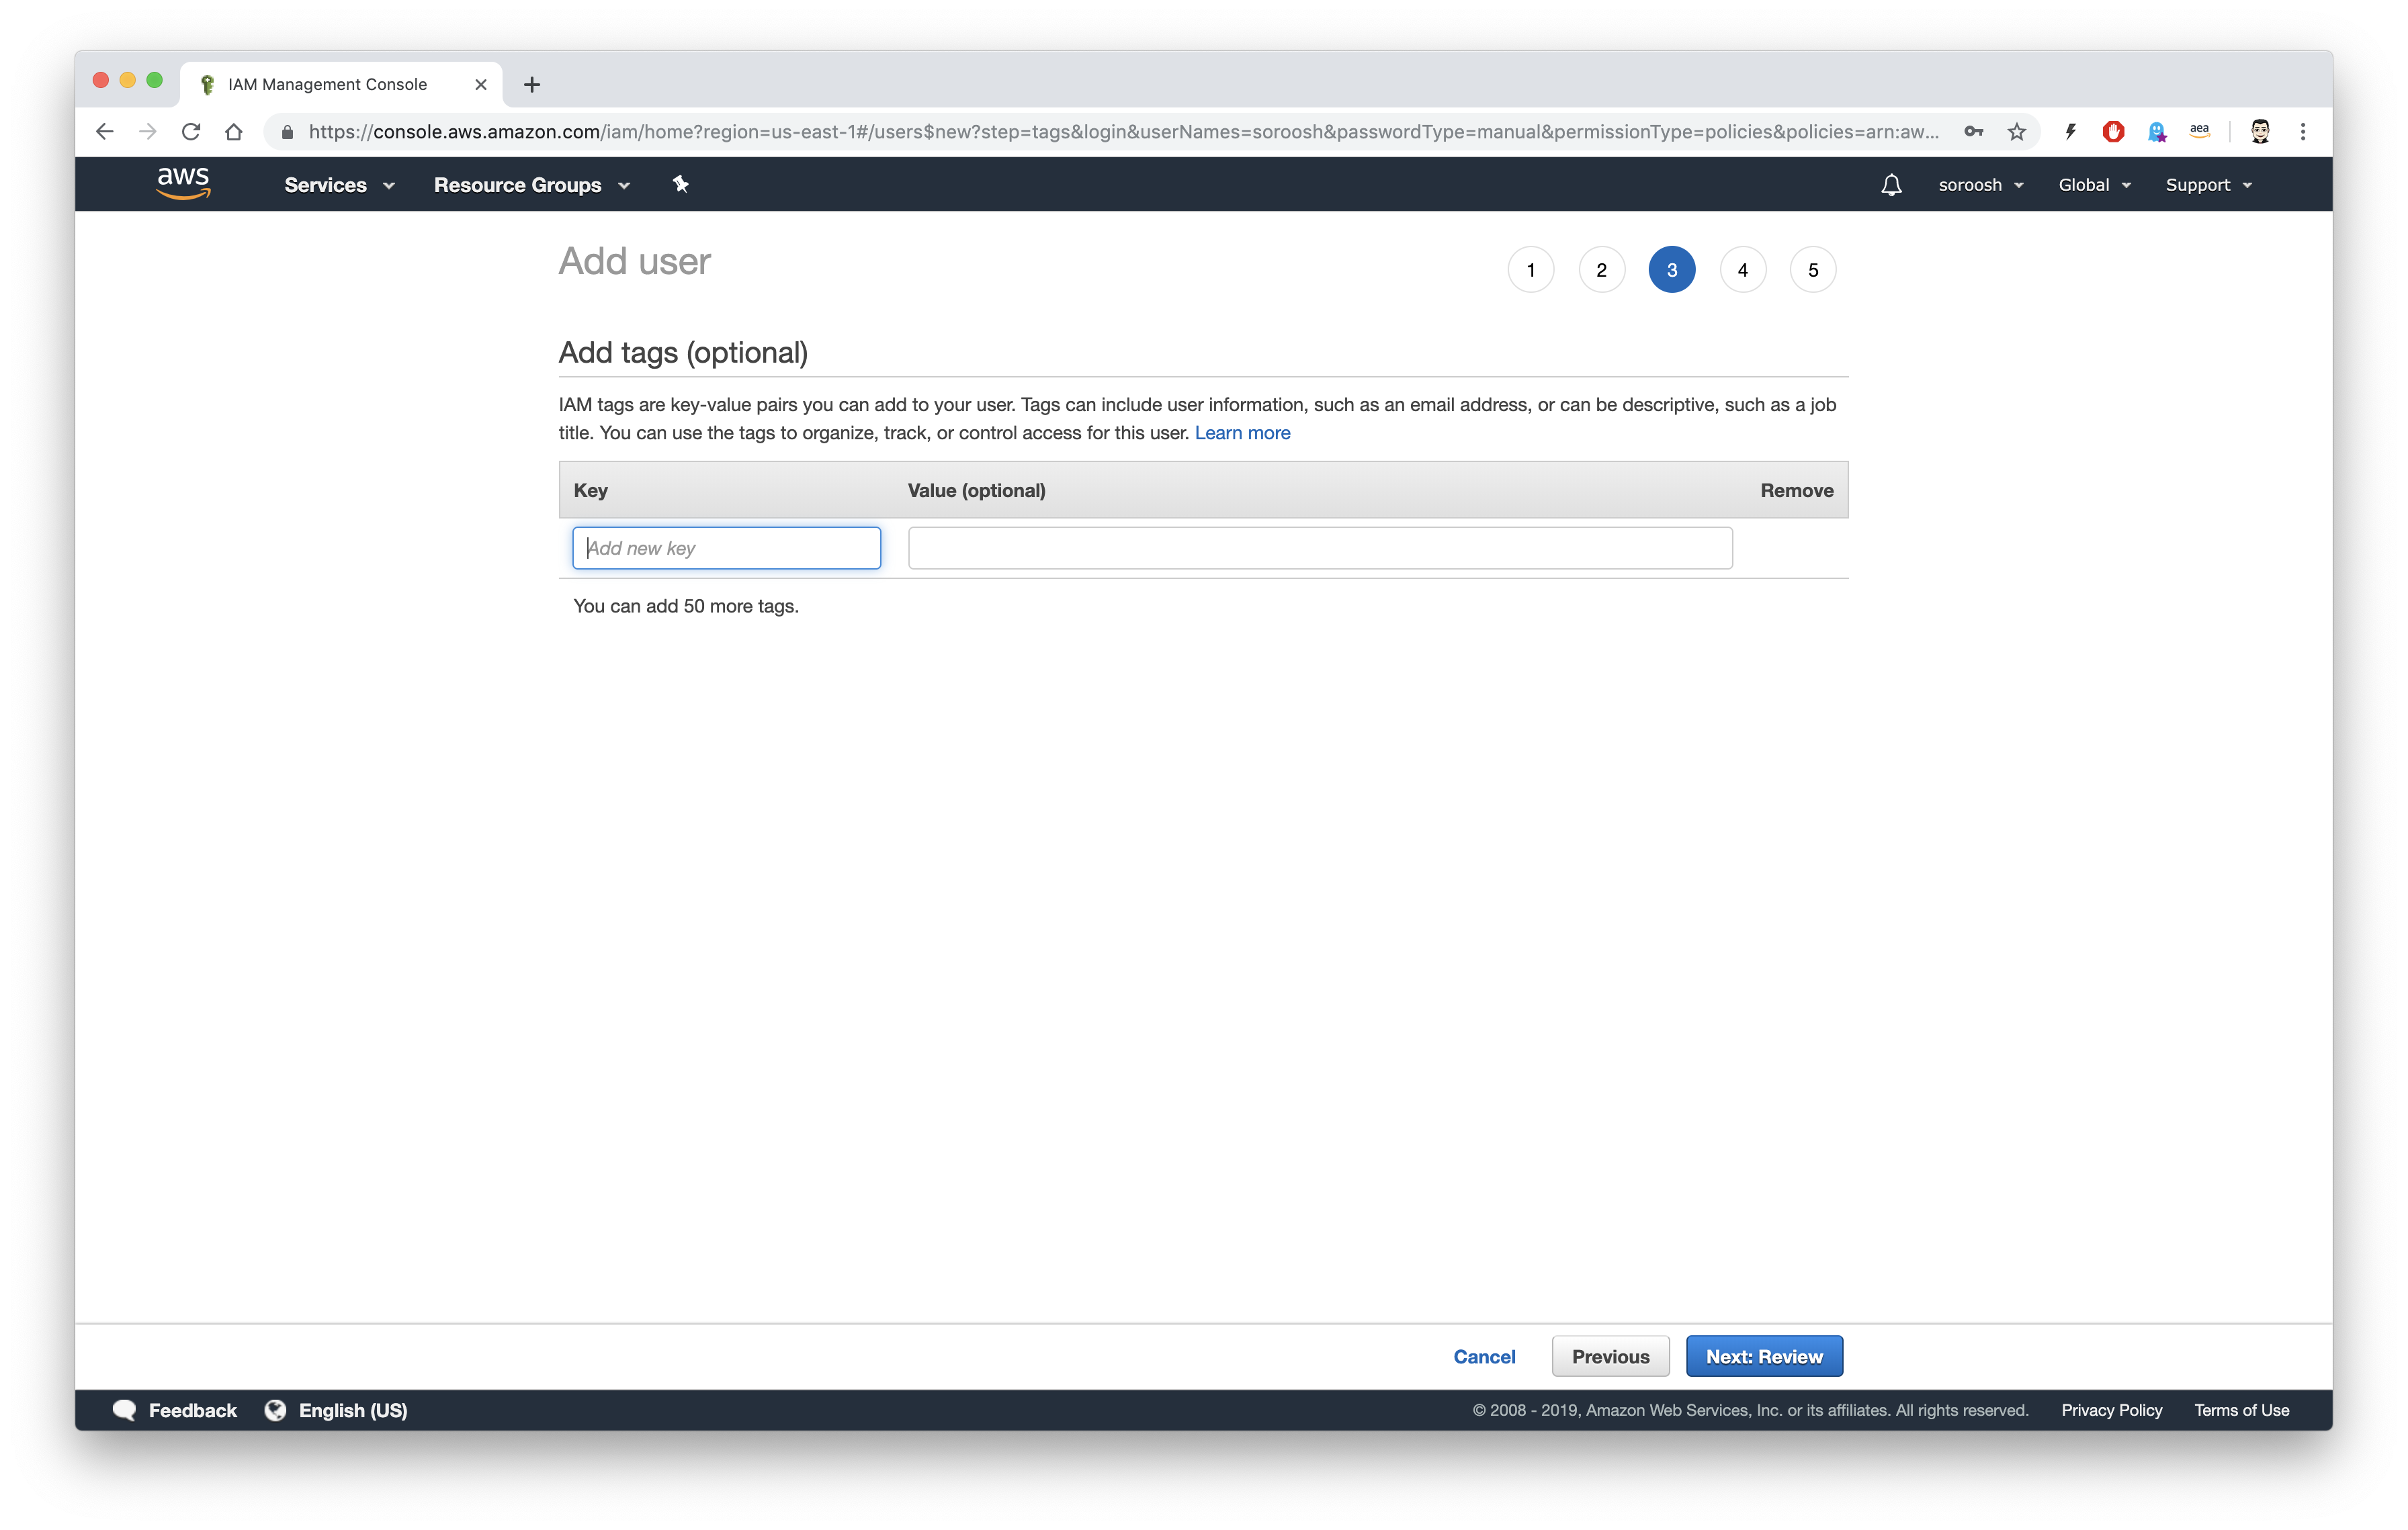

Add tags
Add tags, this is optional, and click on Next: Review.

Slide 20
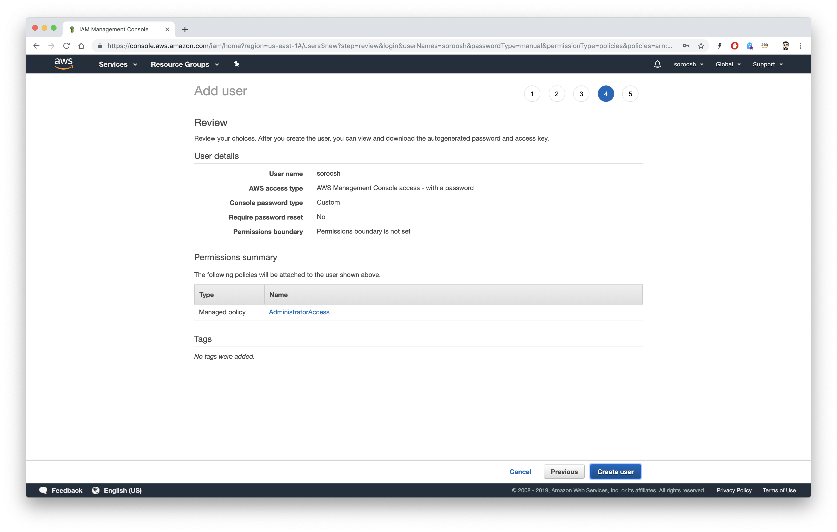

Review and Create User
Review information and click on Create User

Slide 21
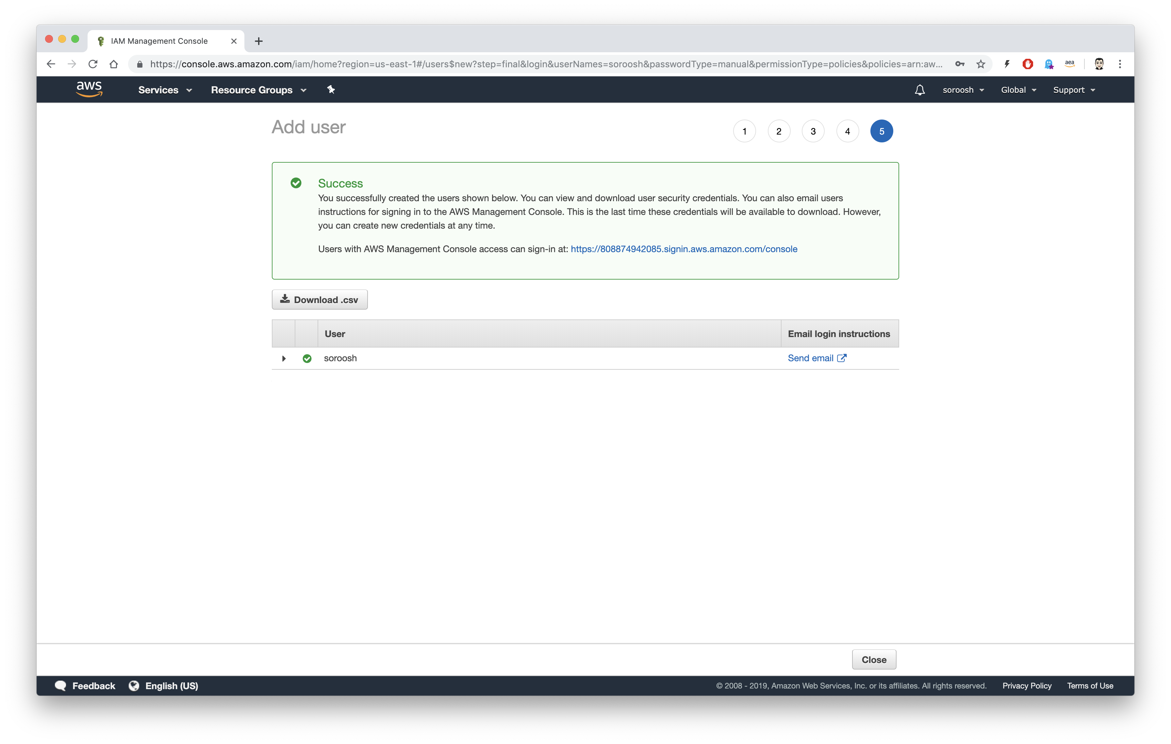

AWS Mangement Console Login URL
Please save the URL and the number. You need the URL or the number to login to AWS management console. This number is your Account ID. Now click on the URL

Slide 22
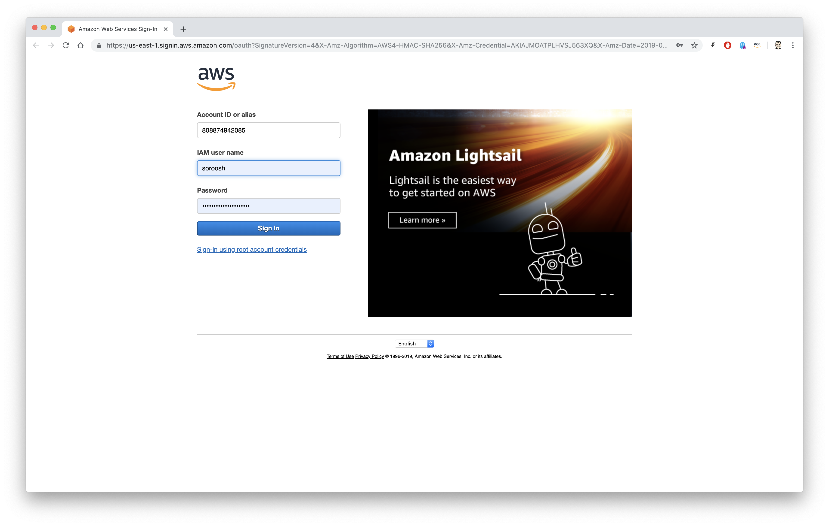

Login in to the console.
Login using your Account ID, new user user name and Password.

